Slide 1


Juan Francisco Araujo Bayas
24/11/2023

Slide 2

Outline
Executive Summary
Introduction
Methodology
Results
Conclusion
Appendix

Slide 3
Executive Summary
Summary of methodologies
The different models used on this project, for the reuse of the first stage prediction are as follows: logistic regression, support vector machine, decision tree classifier, k nearest neighbors.
Summary of all results
The accuracy when testing the different models are as follows:
Logistic regression: 0,833
Support vector machine: 0,833
Decision tree classifier: 0,56
k nearest neighbors: 0,833
Based on those results, we can say that the best prediction models for the reuse of the first stage are: logistic regression, support vector machine, and k nearest neighbors.

Slide 4
Introduction
Project background and context
Companies (Virgin Galactic, Blue Origin, SpaceX), are making space travel affordable for everyone.
SpaceX rocket launches are inexpensive due to the savings made on the reuse of the first stage.
Problems you want to find answers
By gathering information about SpaceX and creating dashboards for our team, we will determine the price of each launch.
By training machine learning model and use public information to predict the outcome, we will determine if SpaceX will reuse the first stage (if successful) or not.

Slide 5

Section 1

Slide 6
Methodology
Executive Summary
Data collection methodology:
In order to collect Data, we had used two ways: first calling an API through an URL in the form of a JSON file, and secondly by doing Web scraping from wikipedia.
Perform data wrangling
This step, was done through three processes: on a first hand we had filtrated some columns that will be used for this project, then we selected launches from the Falcon 9 and lastly we replace numerical missing values (not for non numerical values) by the mean of the variable column.
Perform exploratory data analysis (EDA) using visualization and SQL
Perform interactive visual analytics using Folium and Plotly Dash
Perform predictive analysis using classification models
How to build, tune, evaluate classification models.

Slide 7
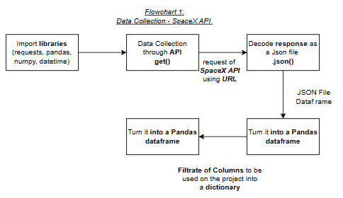
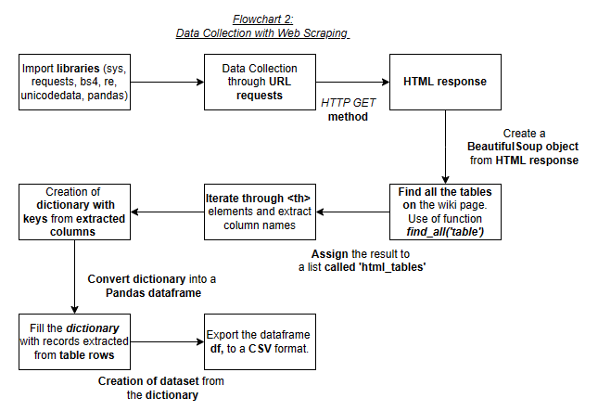
Data Collection
Describe how data sets were collected.
In order to collect Data, we had used two ways: first calling an API through an URL in the form of a JSON file, and secondly by doing Web scraping from wikipedia.

Slide 8
Data Collection – SpaceX API
On this flowchart, we can see the steps done for the data collection with SpaceX REST.
The GitHub URL of the completed SpaceX API calls notebook is shown here: testcapproj/Lab 1 Week 1 Capstone Project python code/Lab1 Week 1 Complete Data Collection with Collection API Lab.ipynb at main · juan15-fran/testcapproj (github.com) . It can be used as an external reference and peer-review purpose.

Slide 9
Data Collection - Scraping
On this flowchart, we can see the steps done for the data collection with Web scraping from wikipedia.
The GitHub URL of the completed web scraping notebook is shown here: testcapproj/Lab2 Week 1 Capstone Project python code/Lab 2 Week 1 Complete the Data Collection with Web Scraping Lab.ipynb at main · juan15-fran/testcapproj (github.com) . It can be used as an external reference and peer-review purpose.

Slide 10
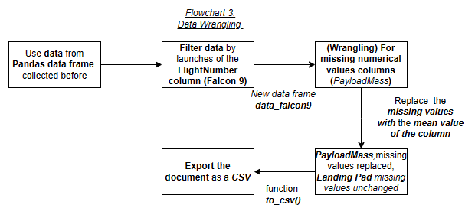
Data Wrangling
After collecting the data, we wrangled the data by replacing some missing values, from PayloadMass column by it´s mean value. And for the Landing Pad column values, we leaved without any change as they aren’t numerical.
The GitHub URL of the completed data wrangling related notebooks is as follows: testcapproj/Lab3 Week 1 Capstone Project python code/Lab 3 Week 1 Data Wrangling.ipynb at main · juan15-fran/testcapproj (github.com) . This can be used as an external reference and peer-review purpose.

Slide 11
EDA with Data Visualization
The charts that were plotted are exposed as follows:
FlightNumber vs PayloadMass (kg): to study their relationship and the frequency of launching failure
FlightNumber vs LaunchSite: to study their relationship and the frequency of launching failure
PayloadMass (kg) vs LaunchSite: study their relationship and the frequency of launching failure
Success Rate and Each Orbit Type: to study their relationship
FlightNumber and Orbit Type: to study their relationship and the frequency of launching failure
PayloadMass and Orbit Type: to study their relationship and the frequency of launching failure
Year and average success rate: to study the average launch success trend
The GitHub URL of the completed EDA with data visualization notebook is as follows: testcapproj/Lab2 Week 2 Falcon 9 First Stage Landing Prediction/Lab 2 Week 2 Falcon 9 First Stage Landing Prediction.ipynb at main · juan15-fran/testcapproj (github.com). It can be used for external reference and peer-review purpose.

Slide 12
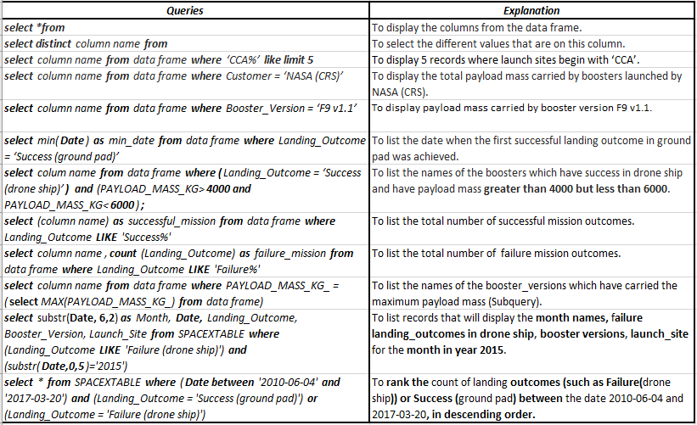
EDA with SQL
The SQL queries performed on the data frame ‘SPACEXTABLE’, for EDA with SQL are exposed as follows:
The GitHub URL of the completed EDA with SQL notebook is as follows: testcapproj/Lab1 Week 2 Complete the EDA with SQL/Lab 1 Week 2 Complete the EDA with SQL .ipynb at main · juan15-fran/testcapproj (github.com). It can be used for external reference and peer-review purpose.

Slide 13
Build an Interactive Map with Folium
The map objects (markers, circles, lines, etc) created and added to a folium map, are as follows:
Highlighted circle area with a text label: to locate each launch site on the map,
MarkerCluster object: to mark the success/failed for each site on the map,
Polyline: to draw a PolyLine between a launch site to the selected coastline point, closest city, railway and highway. This in order to compute the distance among the different points.
The GitHub URL of the completed interactive map with Folium map is as follows: testcapproj/Lab1 Week 3 Interactive Visual Analytics with Folium/Lab1 Week 3 Interactive Visual Analytics with Folium.ipynb at main · juan15-fran/testcapproj (github.com). It can be used for external reference and peer-review purpose.

Slide 14
Build a Dashboard with Plotly Dash
We had created the following plots/graphs and interactions in a dashboard:
Launch Site Drop-down Input Component: to select the Launch Site, from which we want to display the graph information.
Success pie-chart: to display the success rate from the different Launch Site selected from the dropdown.
Range Slider: to select the Payload.
Success-payload-scatter-chart scatter plot: to render the success payload scatter plot.
The GitHub URL of the completed Plotly Dash lab is as follows: testcapproj/Lab2 Week 3 Build an Interactive Dashboard with Plotly Dash/Lab 2 Week 3 spacex_dash_app.py at main · juan15-fran/testcapproj (github.com). It can be used as an external reference and peer-review purpose.

Slide 15
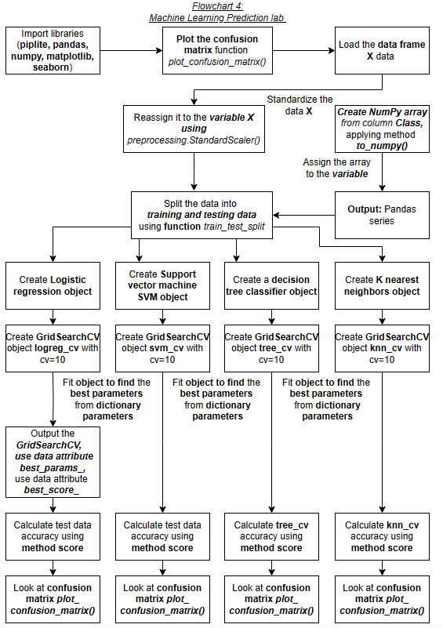
Predictive Analysis (Classification)
In order to predict whether the first stage of Falcon 9 will land successfully, we will use 4 models (Logistic Regression, Support Vector Machine, Decision Tree Classifier and K-nearest Neighbors) which will then be selected taking into account their individual accuracy.
In the following chart we can see the steps done in order to come up with the models.
The GitHub URL of the completed predictive analysis lab is as follows: testcapproj/Lab1 Week 4 Hands-On Lab Complete the Machine Learning Prediction Lab/Lab 1 Week 4 Hands-On Lab Complete the Machine Learning Prediction Lab.ipynb at main · juan15-fran/testcapproj (github.com). It can be used as an external reference and peer-review purpose.

Slide 16
Results
From the Exploratory data analysis we have the following results:
failure mission outcomes are 10 (14,08%), and successful mission outcomes are 61 (85,92%);
the success rate from the different Launch Sites are CCAPS SLC 40 (60%), VAFB SLC 4E (76,92%), KSC LC 39A (77,27%);
the Payload Mass (kg) with the higher success rate are among the following Masses: 1700 (kg) - 2500 (kg), 3800 (kg) - 4300 (kg), 8000 (kg) – 15700 (kg);
The Orbits Type with most of successes are, ES-11, GEO, HEO and SSO. This could be linked to the launch site from where the rocket is launched. Due to the launch aims to a dedicated Orbit.
Interactive analytics demo in screenshots
Predictive analysis results

Slide 17
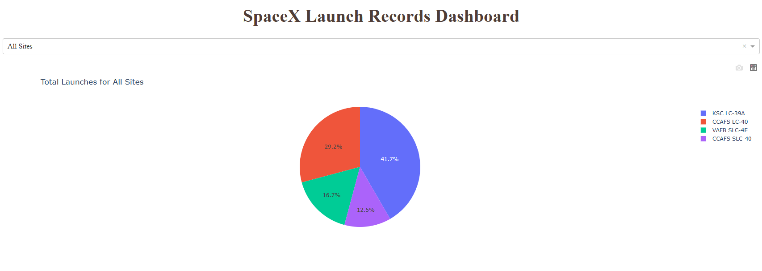
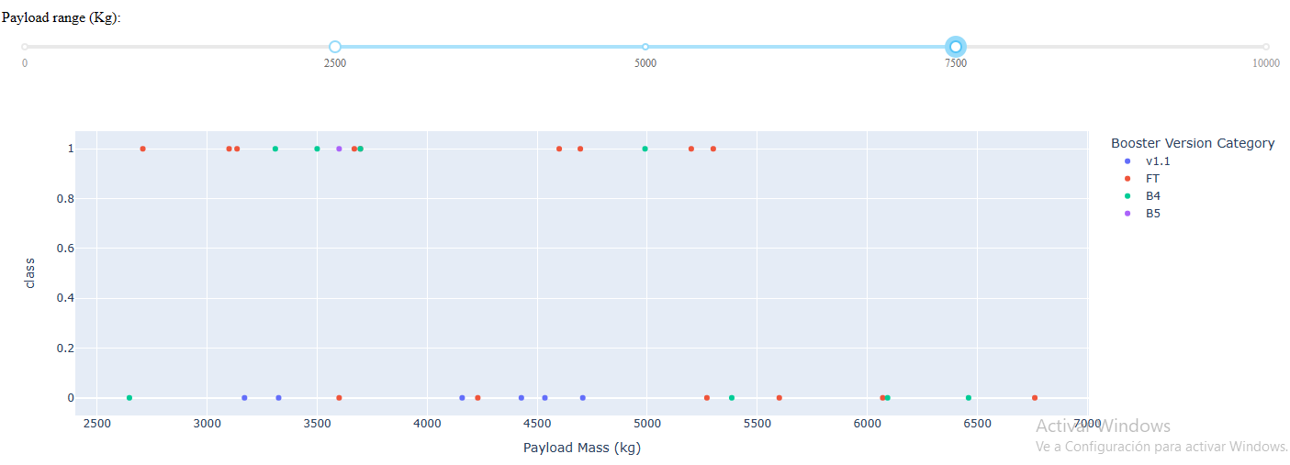
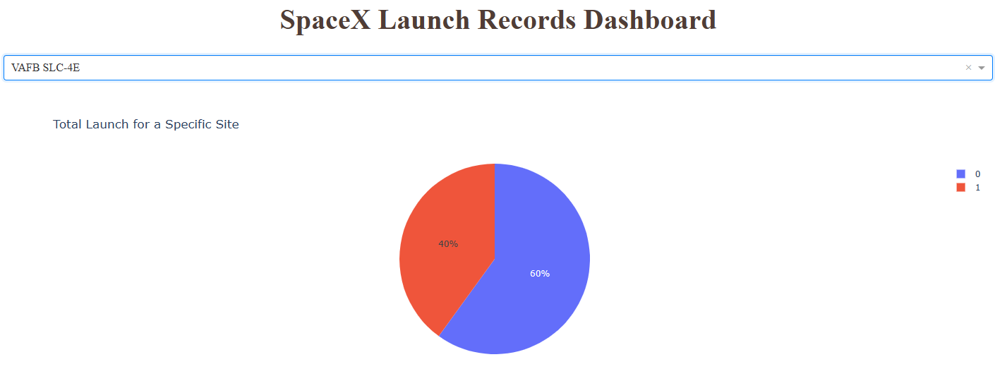
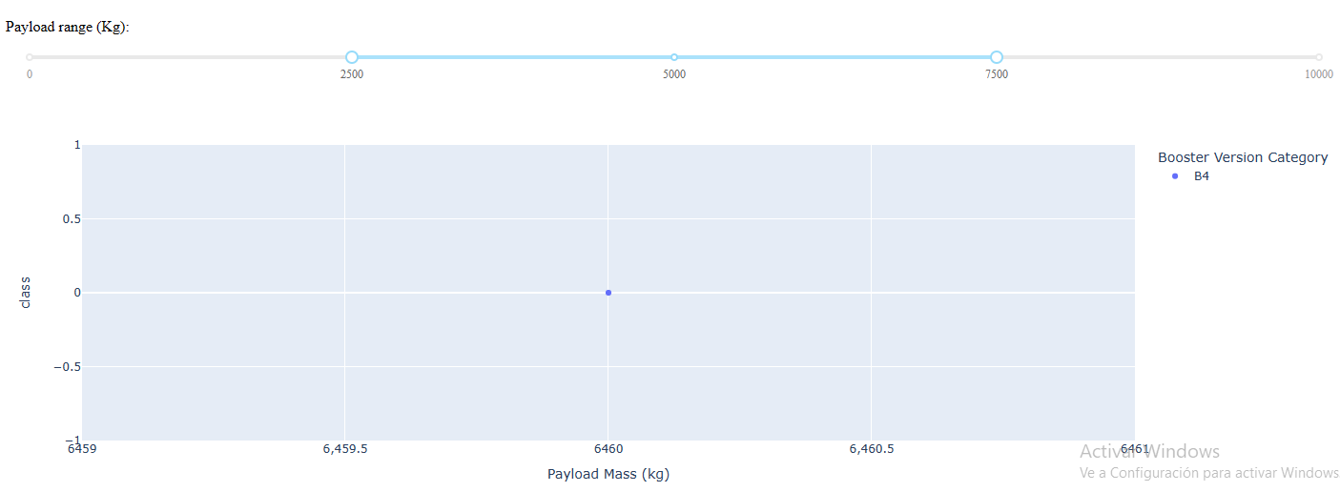
Results
Interactive analytics demo in screenshots

Slide 18
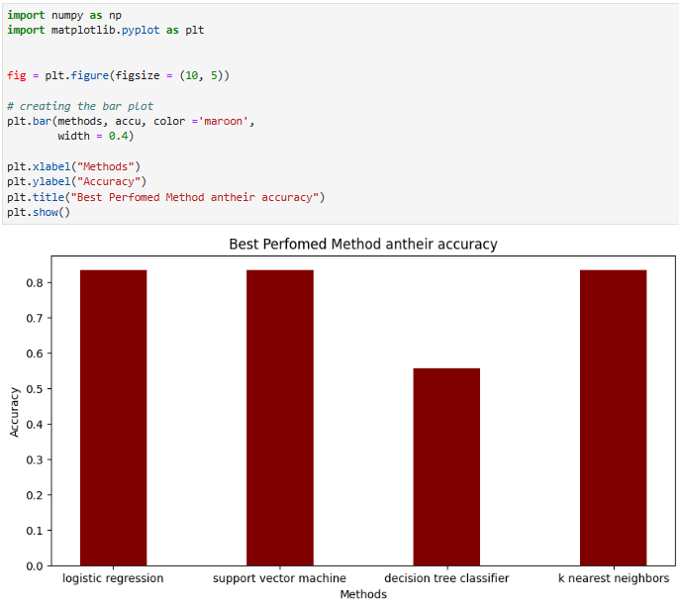
Results
Predictive analysis results
The accuracy when testing the different models are as follows:
Logistic regression: 0,833
Support vector machine: 0,833
Decision tree classifier: 0,56
k nearest neighbors: 0,833
Based on those results, we can say that the best prediction models for the reuse of the first stage are: logistic regression, support vector machine, and k nearest neighbors.

Slide 19

Section 2

Slide 20
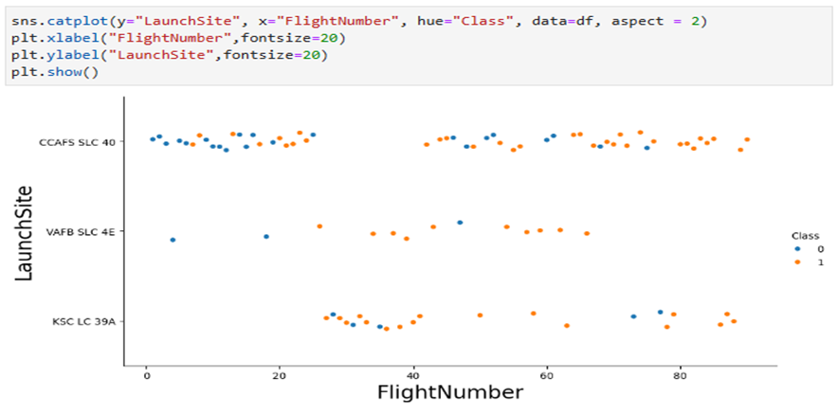
Flight Number vs. Launch Site
Scatter plot of Flight Number vs. Launch Site
In this scatter plot we can see through the data of class (1= success; 0= fail) the success rate from the different Launch Sites are:
CCAPS SLC 40 (60%),
VAFB SLC 4E (76,92%),
KSC LC 39A (77,27%).

Slide 21
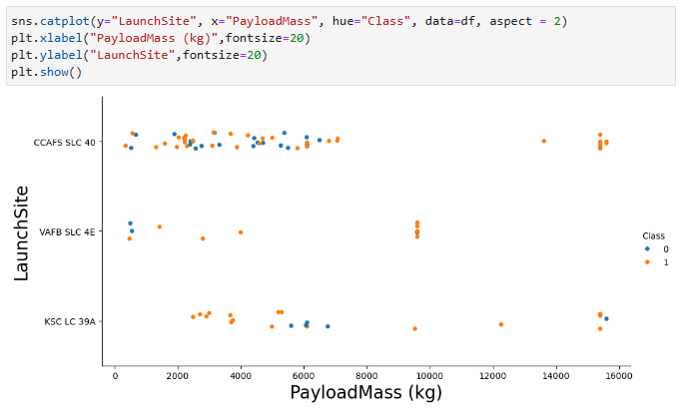
Payload vs. Launch Site
Scatter plot of Payload vs. Launch Site
In this scatter plot we can see through the data of class (1= success; 0= fail), that the Payload Mass (kg) with the higher success rate are among the following Masses:
1700 (kg) - 2500 (kg)
3800 (kg) - 4300 (kg)
8000 (kg) – 15700 (kg)

Slide 22
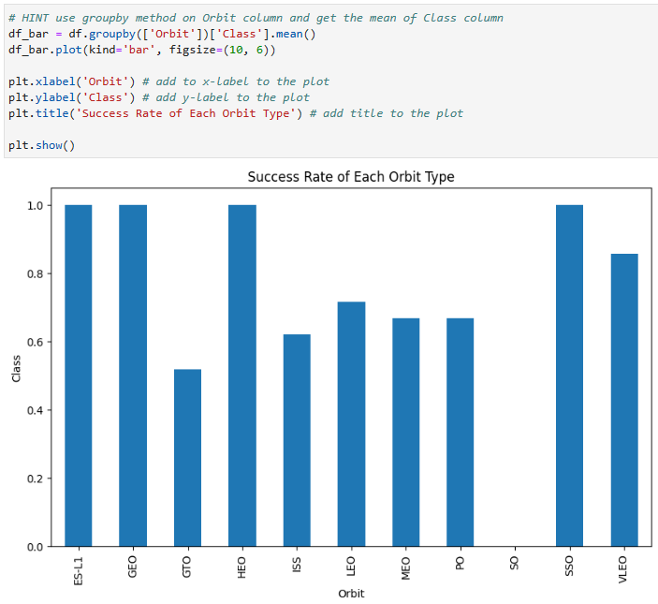
Success Rate vs. Orbit Type
On the right hand side, we can see a bar chart of the success rate of Each Orbit Type.
The Orbits Type with most of successes are, ES-11, GEO, HEO and SSO. This could be linked to the launch site from where the rocket is launched. Due to the launch aims to a dedicated Orbit.

Slide 23
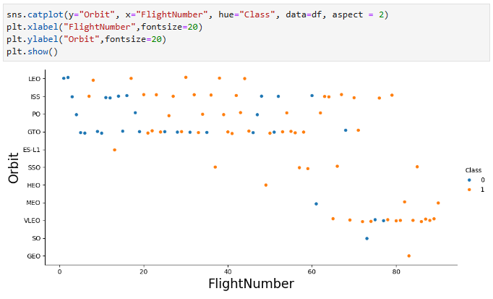
Flight Number vs. Orbit Type
On the right hand side, we can see the scatter plot of the Flight Number vs Orbit Type. Where blue points shows fail launches and orange points shows success launches.
On this scatter plot we can see that the Orbit type with the most failure rate are: SO, GTO, ISS, VLEO and LEO. The rate, could change with more launches made to each Orbit Type.

Slide 24
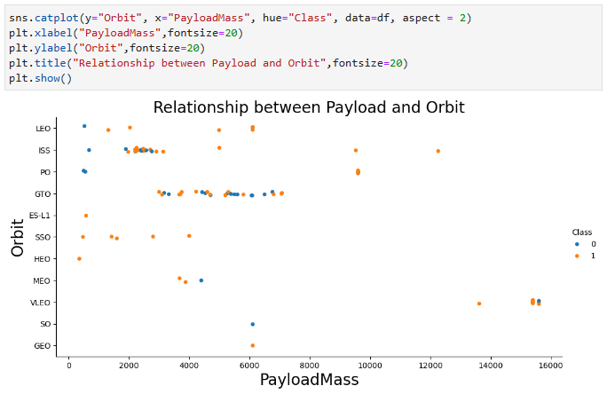
Payload vs. Orbit Type
On the right hand side, we can see the scatter plot of the PayloadMass vs Orbit Type. Where blue points shows fail launches and orange points shows success launches.
The Orbits Type with most of successes are, ES-11, GEO, HEO and SSO. This could be linked to the launch site from where the rocket is launched. Due to the launch aims to a dedicated Orbit. We can say that is more linked to the launch site, than to the PayloadMass, as with the same PayloadMass we have failures for other Orbit Types of rocket launches.

Slide 25
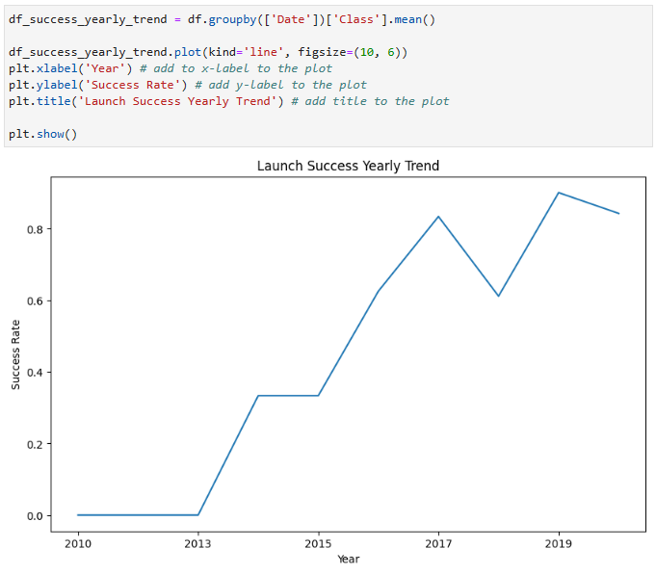
Launch Success Yearly Trend
On the right hand side, we can see the plot line chart of the Launch Success Yearly Trend from 2013 to 2020.
The increase on improvement on success rate, through the years could be explained due to the improvements made on the rocket launch from old failed launches.

Slide 26
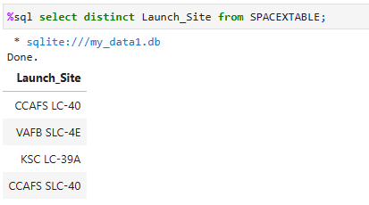
All Launch Site Names
In order to display the names from the different launch sites in the space mission, we had used the following query:
select distinct Launch_Site from SPACEXTABLE.

Slide 27
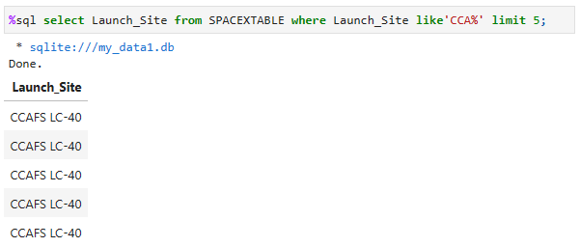
Launch Site Names Begin with 'CCA'
In order to display, 5 records where launch sites begin with `CCA`. We had used the following query:
select Launch_Site from SPACEXTABLE where Launch_Site like ‘CCA%’ limit5.

Slide 28
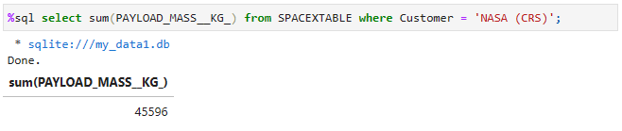
Total Payload Mass
In order to compute the total payload mass carried by boosters from NASA (CRS). We have used the following query:
select sum(PAYLOAD_MASS_KG_) from SPACEXTABLE where Customer = ‘NASA (CRS)’.

Slide 29
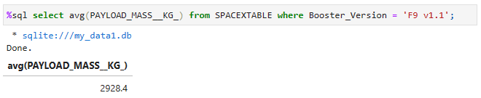
Average Payload Mass by F9 v1.1
In order to compute the average payload mass carried by booster version F9 v1.1
select avg(PAYLOAD_MASS_KG) from SPACEXTABLE where Booster_Version = ‘F9 v1.1’.

Slide 30
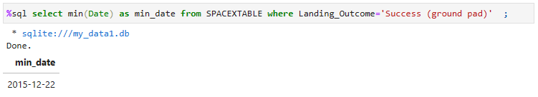
First Successful Ground Landing Date
In order to find the dates of the first successful landing outcome on ground pad, we had used the following query:
select min(Date) as min_date from SPACEXTABLE where Landing_Outcome=‘Success (ground pad)’.

Slide 31
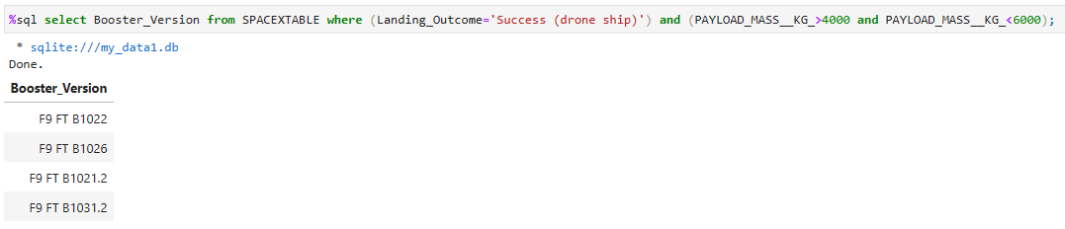
Successful Drone Ship Landing with Payload between 4000 and 6000
In order to list the names of boosters which have successfully landed on drone ship and had payload mass greater than 4000 but less than 6000, we had used the following query:
select Booster_Version from SPACEXTABLE where (Landing_Outcome=‘Success (drone ship)’) and (PAYLOAD_MASS_KG_>4000 and PAYLOAD_MASS_KG_<6000).

Slide 32
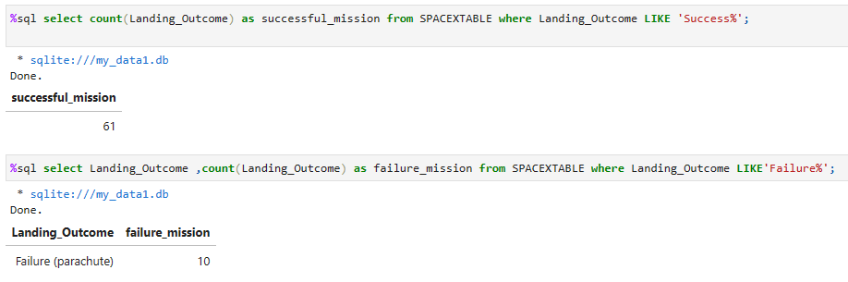
Total Number of Successful and Failure Mission Outcomes
In order to compute the total number of successful and failure mission outcomes, we had used the following queries:
Select Landing_Outcome ,count (Landing_Outcome) as successful_mission from SPACEXTABLE where Landing_Outcome LIKE ‘Success%’.
Select Landing_Outcome ,count (Landing_Outcome) as failure_mission from SPACEXTABLE where Landing_Outcome LIKE ‘Failure%’.

Slide 33
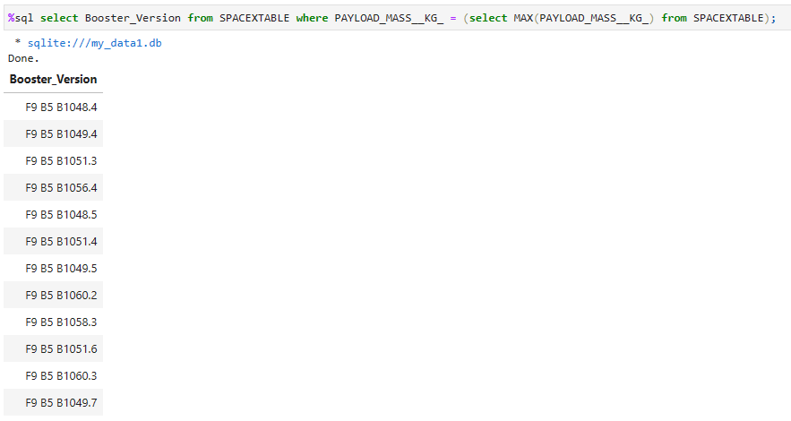
Boosters Carried Maximum Payload
In order to list the names of the booster which have carried the maximum payload mass, we had used the following query:
select Booster_Version from SPACEXTABLE where PAYLOAD_MASS_KG = (select MAX(PAYLOAD_MASS_KG_) from SPACEXTABLE.

Slide 34
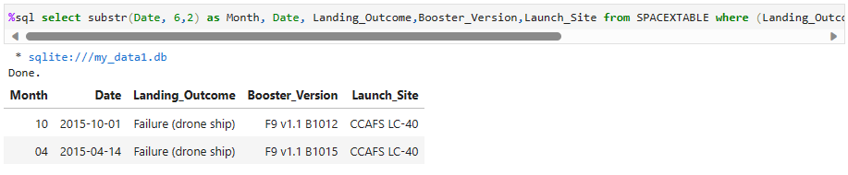
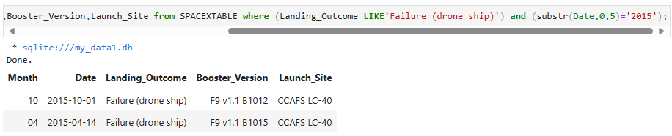
2015 Launch Records
To list the failed landing_outcomes in drone ship, their booster versions, and launch site names for in year 2015, we had used the following query:
select substr(Date, 6,2) as Month, Date, Landing_Outcome,Booster_Version,Launch_Site from SPACEXTABLE where (Landing_Outcome LIKE ‘Failure (drone ship)’) and (substr(Date,0,5) =‘2015’).

Slide 35
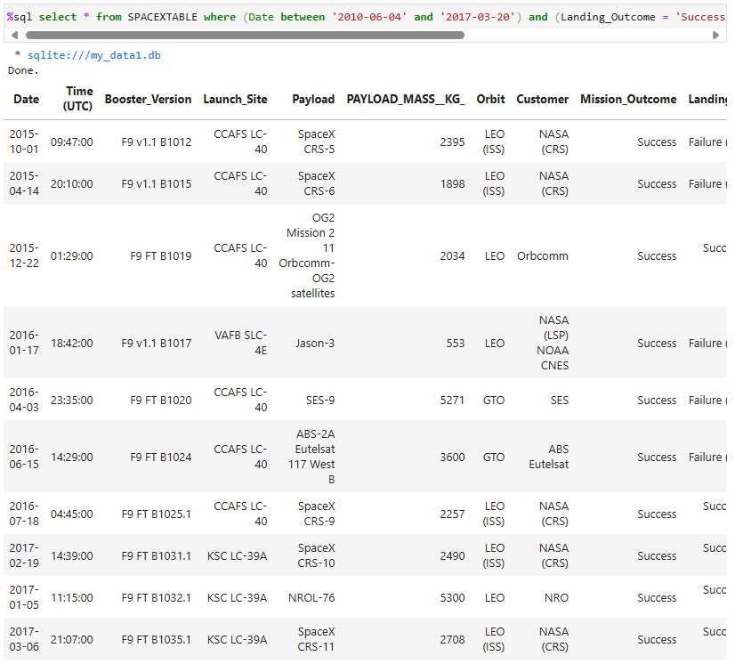
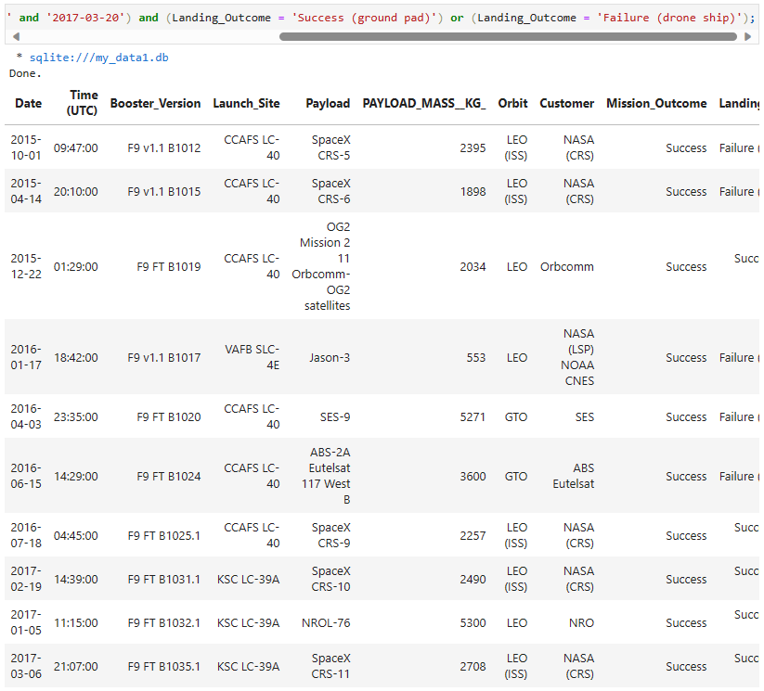
Rank Landing Outcomes Between 2010-06-04 and 2017-03-20
In order to rank the count of landing outcomes (such as Failure (drone ship) or Success (ground pad)) between the date 2010-06-04 and 2017-03-20, in descending order. We had used the following query:
select * from SPACEXTABLE where (Date between ‘2010-06-04’ and ‘2017-03-20’) and (Landing_Outcome = ‘Success (ground pad)’) or (Landing_Outcome= ‘Failure (drone ship)’).

Slide 36

Section 3

Slide 37
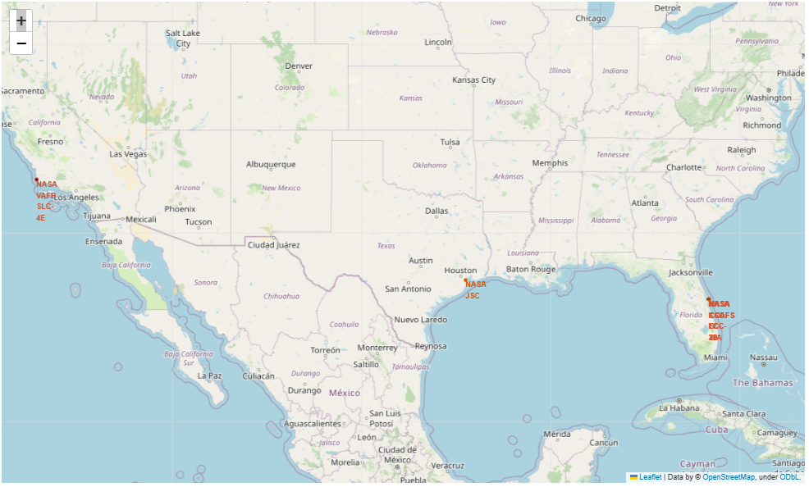
Folium Map of all launch sites’ location on a global map
In the following image, we illustrate the generated folium map and include all launch sites’ location markers on a global map:
The four Launch Site locations are near by the ocean, which can be explained due to the fact that after launching a rocket, many pieces are thrown and recuperated on the ocean.

Slide 38
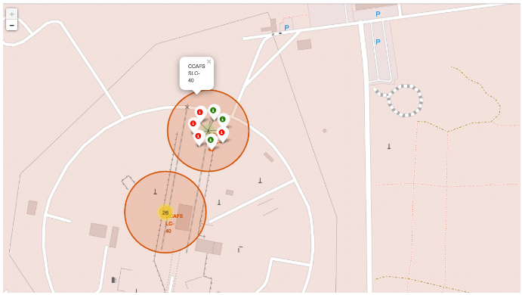
Folium Map of the colored-labeled launch outcomes
In the following image, we illustrate the color-labeled launch outcomes on the map:
The color-labeled launch outcomes on the map, shows on green the successful launches and on red the failed launches, from CCAFS SLC-40 Launch Site.

Slide 39
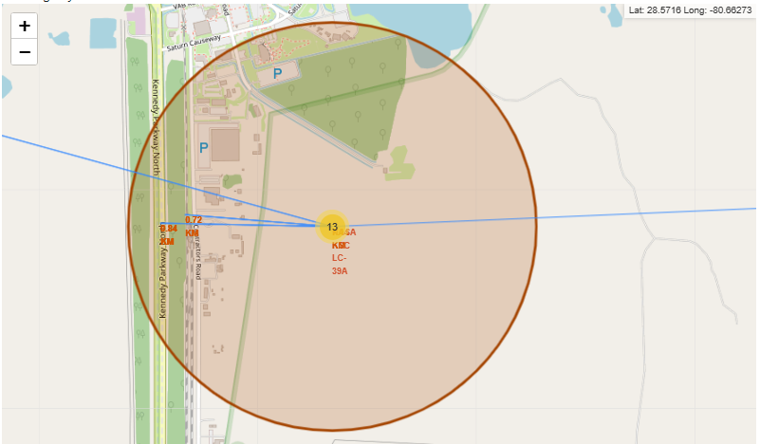
Folium Map from proximities of KSC LC-39A Launch Site
In the following image, we illustrate the generated folium map of KSC LC-39A launch site to its proximities such as railway, highway, coastline, with distance calculated and displayed.
As we can see it’s important that the Launch Site, it´s near railway, highway and the coastline in order to manage the supply chain of the rocket launch. However it´s away from different cities due to risks management reasons (sound pollution…).

Slide 40

Section 4

Slide 41
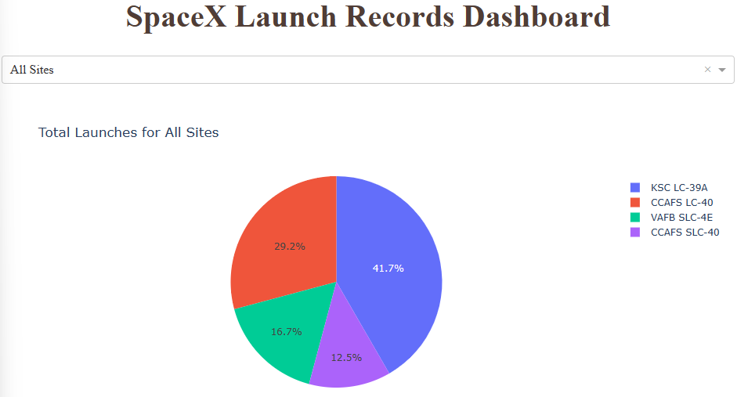
Interactive Dashboard of Launches from all Launch Sites
In the following piechart, we can see the percentage of launches from all sites.
On the following piechart, we see that the Launch Site were there are more launches is KSC LC-39A, then it is followed by: CCAFS LC-40, VAFB SLC-4E and CCAFS SLC-40.

Slide 42
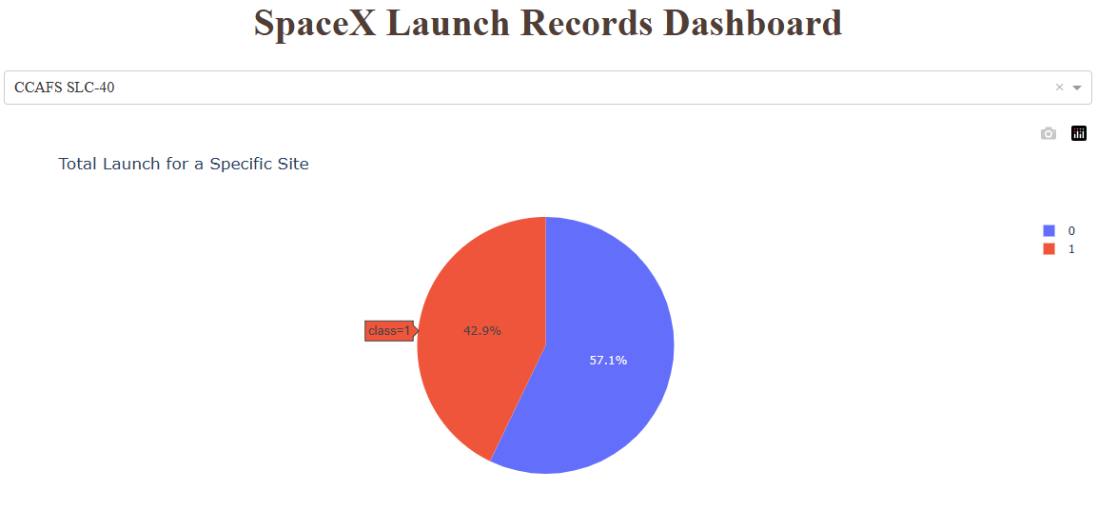
PIECHART FOR THE LAUNCH SITE WITH HIGHEST LAUNCH SUCCESS RATIO
In the following piechart, we see the piechart from CCAFS SLC-40 launch site with the highest launch success ratio.
On this piechart we see that from the rocket launched from CCAFS SLC-40, we have 42,9% of success and 57,1% of failure.

Slide 43
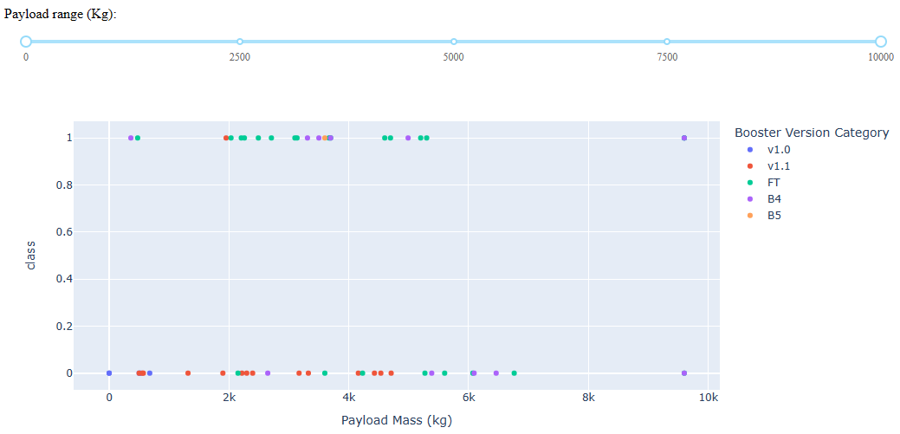
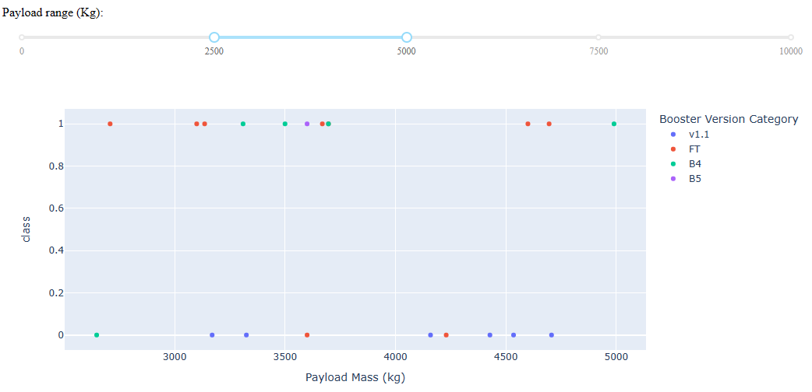
Interactive dashboard of Payload Mass vs Launch Outcome for all sites
In the following scatter plot for all sites, we see different payload mass selected in the range slider.
By changing the Payload Mass (Kg), we can see that the Booster Version Category v1.0 don´t appear anymore. Also the success rate increase among the different Payload Mass (Kg).

Slide 44

Section 5

Slide 45
Classification Accuracy
In the bar chart, we can visualize the model accuracy for all built classification models.
We have three models with the best accuracy, that are: logistics regression, support vector machine and knearest neighbors.

Slide 46
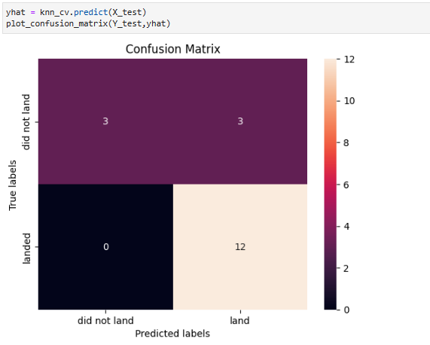
Confusion Matrix
The following confusion matrix represent the results from the 4 best performing models. Here we can see that from the 18 predicted labels, 15 had the same output from the True labels, which is different from appendix 1 that shows the confusion matrix from K nearest neighbors model. Those tests and matrix can help to measure the accuracy of the predictive model.

Slide 47
Conclusions
On a first hand, after going through different processes to build our predictive models we had found through the dashboard created, different variables that had an impact on the outcome of failure or not of a rocket launch from SpaceX. Those are: Launch Site, Orbit Type, Payload Mass (Kg) and Booster Version Category. The failure of the rocket launch, has a negative direct impact on the reusage of the first stage and on the cost of rocket launches as well. This because, the first stage is expensive.
On a second hand, regarding the predictive model, we had found that 3 of them could be useful due to their accuracy, to predict whether a rocket launch will be successful or not. The rocket launch success prediction will be helpful to define whether the first stage could be reused or not, which impact positively the definition of the price of each launch.

Slide 48
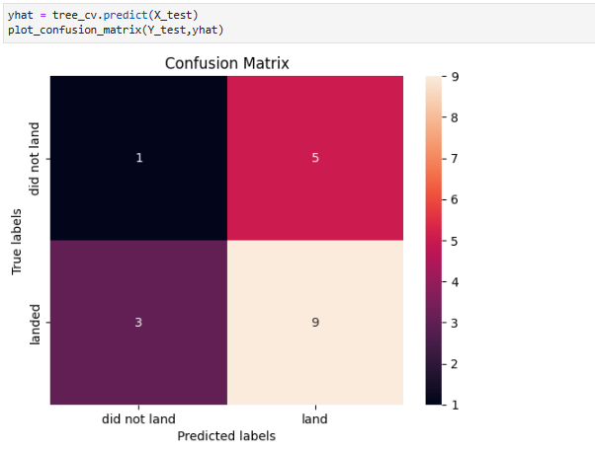
Appendix 1 Confusion Matrix from k nearest neighbors model
The following confusion matrix represent the results from the model less accurate, that is k nearest neighbors model.

Slide 49


